Slide 1
Media Literacy & Me
Student Health & Human Services
Office of Human Relations, Diversity & Equity
June 2022
Notes:
Teacher, thank you for choosing to share this Advisory Lesson with your class!

Slide 2
Welcome Do you prefer...
TV
MOVIE
BOOK
Notes:
Engage the students in the check in question.

Slide 3
Objectives
Learn about media literacy and how media influences our attitudes towards people
Watch clips from TV shows and Movies portraying various stereotypes
Reflect on how these subtle, and not-so-subtle, messages impact our world
Notes:
Read the objectives aloud for the students.

Slide 4
What is Media Literacy?
Notes:
Play the video for the students (3:00)
https://www.youtube.com/watch?v=ZaMzYDe0taY

Slide 5
Questions to Ask Yourselves
What is it telling you?
Does it tell you to be or act a certain way?
How does it make you feel?
Notes:
Advise the students that we are going to watch a few more video clips and we want to invite them to be reflective of what the clip is trying to tell them about specific characters.

Slide 6
WATCH
Notes:
https://www.youtube.com/watch?v=qVdgaSuAjII
(2:40)

Slide 7
Questions to Ask Yourselves
What is it telling you?
Does it tell you to be or act a certain way?
How does it make you feel?
Notes:
Advise the students that we are going to watch a few more video clips and we want to invite them to be reflective of what the clip is trying to tell them about specific characters.

Slide 8
wATCH
Notes:
https://www.youtube.com/watch?v=Co0TOqe8zOw
1:09

Slide 9
Questions to Ask Yourselves
What is it telling you?
Does it tell you to be or act a certain way?
How does it make you feel?
Notes:
Advise the students that we are going to watch a few more video clips and we want to invite them to be reflective of what the clip is trying to tell them about specific characters.

Slide 10
Watch
Notes:
https://www.youtube.com/watch?v=1DxH5rqKF9I
3:26

Slide 11
Questions to Ask Yourselves
What is it telling you?
Does it tell you to be or act a certain way?
How does it make you feel?
Notes:
Advise the students that we are going to watch a few more video clips and we want to invite them to be reflective of what the clip is trying to tell them about specific characters.

Slide 12
Watch
Notes:
https://www.youtube.com/watch?v=fO263dPKqns (3:13)

Slide 13
Questions to Ask Yourselves
What is it telling you?
Does it tell you to be or act a certain way?
How does it make you feel?
Notes:
Advise the students that we are going to watch a few more video clips and we want to invite them to be reflective of what the clip is trying to tell them about specific characters.

Slide 14
Reflection
What are some take-aways you have from the few clips we saw?
Are there any other character stereotypes that stick out in your head from TV or movies?
What is a character you WISH you would see on TV or in movies?
Notes:
Engage the students in the reflection questions.

Slide 15
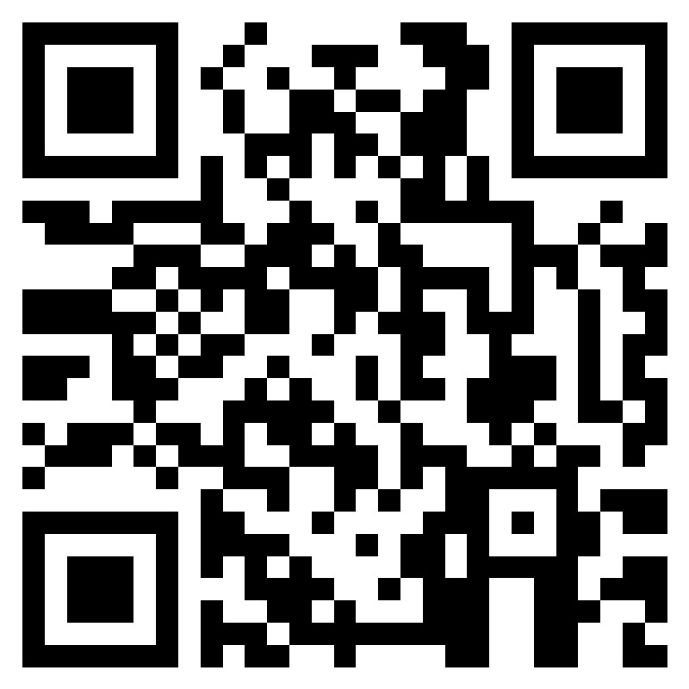
Teacher Feedback Survey
Notes:
Teacher, please scan the QR code or click the link below to take a brief survey
https://forms.office.com/r/i9UqyyxzTT

Slide 16
Human Relations, Diversity & Equity

